Slide 1



Adventure Work Sales report
View in Power BI
Last data refresh:
2/28/2025 3:26:58 AM UTC
Downloaded at:
2/28/2025 3:31:03 AM UTC

Slide 2
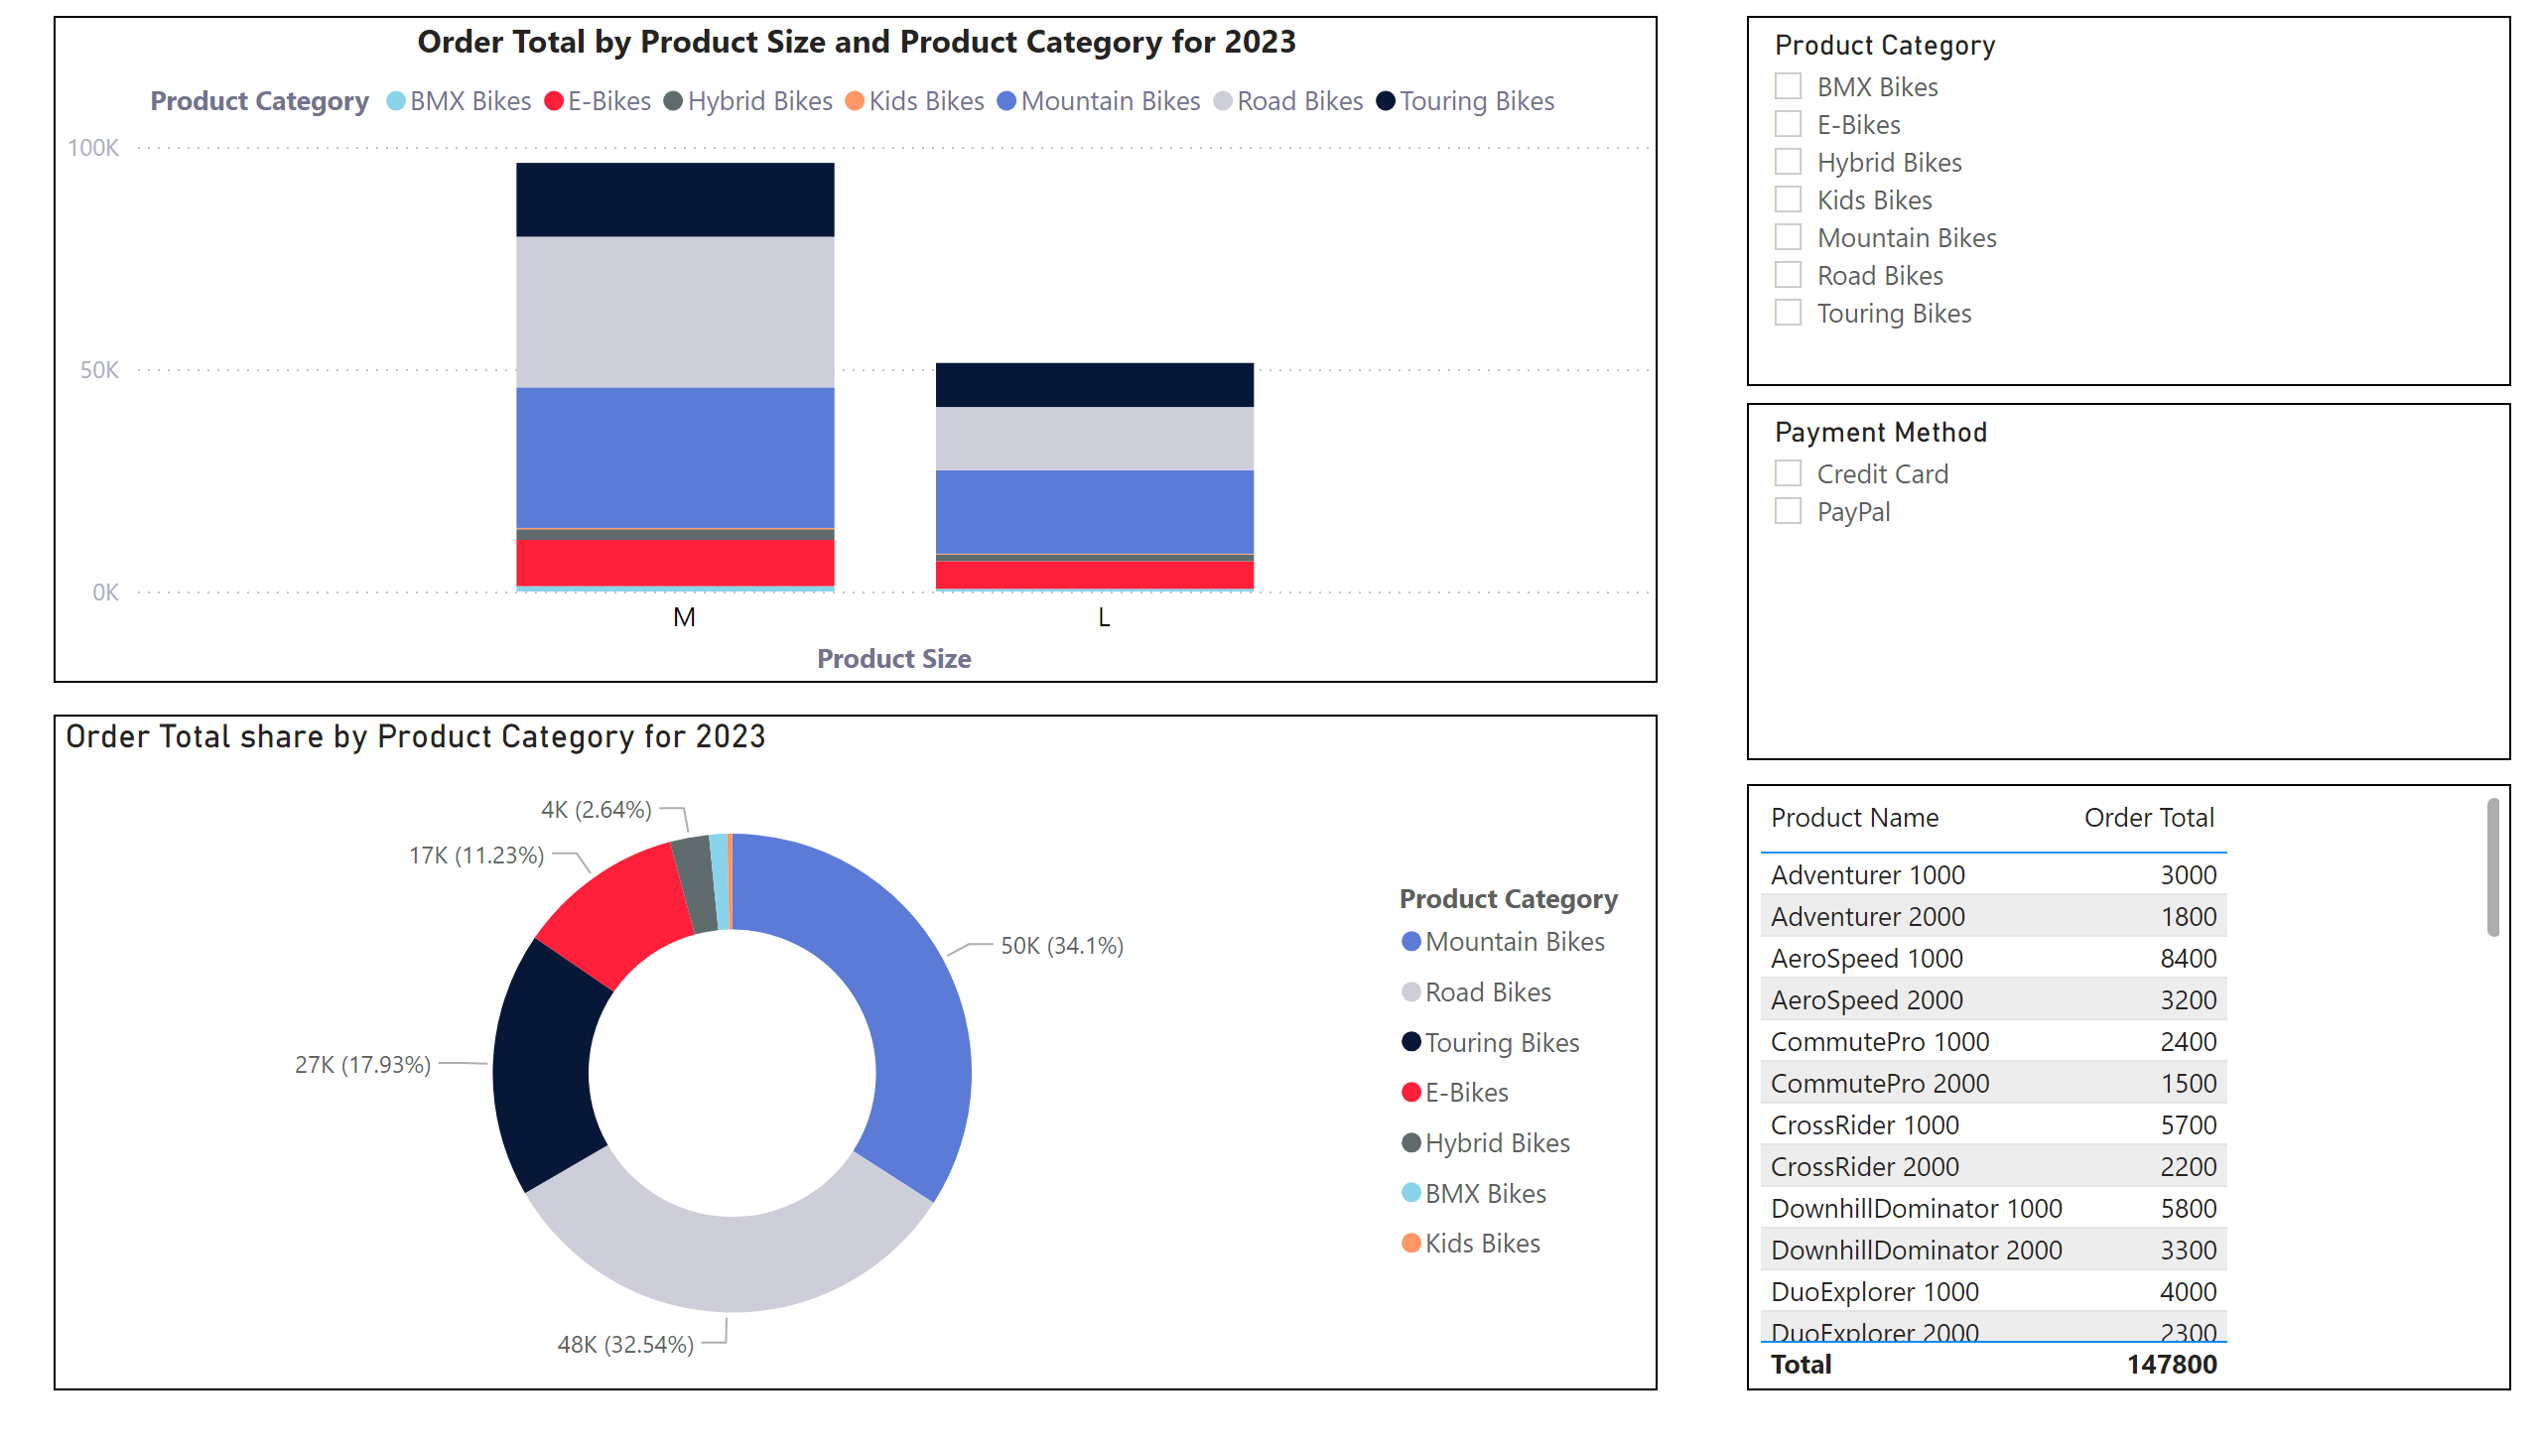
Page 1
Notes:
slicer
No alt text provided
slicer
No alt text provided
Order Total by Product Size and Product Category for 2023
No alt text provided
Order Total share by Product Category for 2023
No alt text provided
tableEx
No alt text provided

